Slide 1

Topic 8: Many-To-Many Relationship
Web Framework Programming
Jurusan Teknik Informatika,Fakultas Teknik
Universitas Surabaya

Slide 2
Many-to-Many Relationship
https://laravel.com/docs/7.x/eloquent-relationships#many-to-many

Slide 3
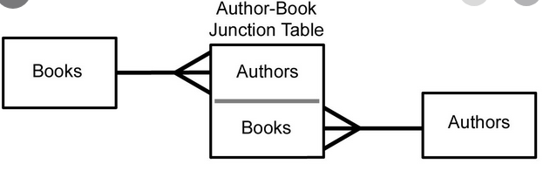
Many-to-Many Relationship
The normalization of the Many-to-many is different from that of the one-to-many. In many-to-many relationship will produces 1 new table junction (table junction) which acts as an intermediary between 2 related tables.

Slide 4
Another example
Explanation of Relation between User and Role is specific user can have various roles and conversely specific role can consist of many accounts/users.
Regarding e-commerce, this relationship also occurs in transactions where one sale transaction consists of many variants of goods.

Slide 5
Rule of Naming
From definition of a many-to-many relationship, the rule name of table junction is (a) singular for each table name; (b) in alphabetical order; (c) separated by underscore (_)
Example:
Users and roles → role_user
Books and authors, → author_book

Slide 6
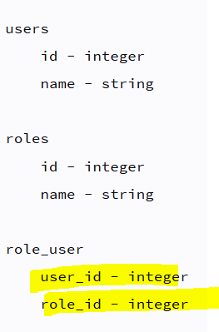
Column Structure from Junction Table
The naming of the junction table column is based on the singular table of each table name with _id
Each of these columns becomes a Primary key and Foreign Key

Slide 7
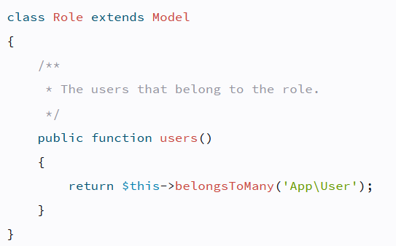
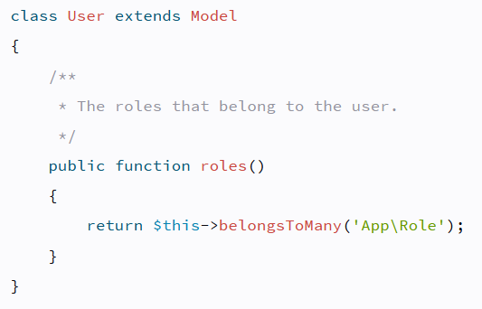
Model Structure
To define a many-to-many relationship, Laravel provides the belongsToMany(…..) keyword.
If you look at the examples of users and roles, then the form of the relationship is as follows:
Both in terms of Users and Roles have the same keywords

Slide 8
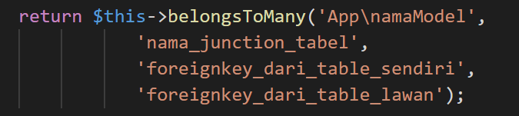
Overriding Mechanism
If the column names or table names don't match the Laravel name convention, you can use
If you look at the example above, belongsToMany is placed in the User model

Slide 9
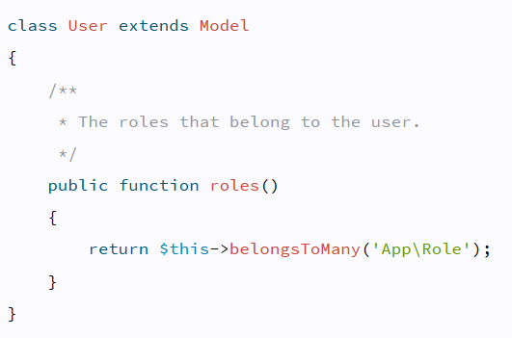
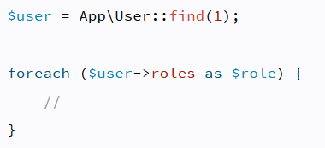
Accessing many-to-many relationship
User Model Structure
Therefore to receive data roles, you can access as follow:

Slide 10
If the junction table has extra columns/parameters
And if the junction table has created_at & updated_at and Laravel eloquent needs to maintain this then pass the keyword withTimestamps

Slide 11
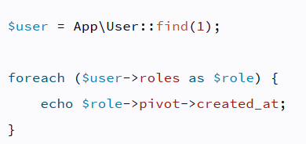
Retrieve data in the column that is in the junction table
The junction table does not only contain foreignkey columns from related tables. You can use the 'pivot' keyword.
In the case above, you want to see what time of user with id = 1 was created
The created_at shown is in the table junction (i.e. role_user)

Slide 12
Adaptation of Transaction Database Structure in the Case Study

Slide 13
Add Table Buyers and Transaction in your database
CREATE TABLE `buyers` (
`id` bigint(20) UNSIGNED NOT NULL,
`name` varchar(100) NOT NULL,
`address` varchar(200) NOT NULL,
`created_at` timestamp NULL DEFAULT NULL,
`updated_at` timestamp NULL DEFAULT NULL
)

Slide 14
CREATE TABLE `transactions` (
`id` bigint(20) UNSIGNED NOT NULL,
`buyer_id` bigint(20) UNSIGNED NOT NULL,
`user_id` bigint(20) UNSIGNED NOT NULL,
`transaction_date` datetime NOT NULL,
`created_at` timestamp NULL DEFAULT NULL,
`updated_at` timestamp NULL DEFAULT NULL
);
CREATE TABLE `medicine_transaction` (
`medicine_id` bigint(20) UNSIGNED NOT NULL,
`transaction_id` bigint(20) UNSIGNED NOT NULL,
`quantity` int(11) NOT NULL,
`price` double NOT NULL
)

Slide 15
ALTER TABLE `buyers`
ADD PRIMARY KEY (`id`);
ALTER TABLE `medicine_transaction`
ADD PRIMARY KEY (`medicine_id`,`transaction_id`),
ADD KEY `medicine_transaction_transaction_id_foreign` (`transaction_id`);
ALTER TABLE `transactions`
ADD PRIMARY KEY (`id`),
ADD KEY `transactions_buyer_id_foreign` (`buyer_id`),
ADD KEY `transactions_user_id_foreign` (`user_id`);
ALTER TABLE `buyers`
MODIFY `id` bigint(20) UNSIGNED NOT NULL AUTO_INCREMENT;

Slide 16
ALTER TABLE `transactions`
MODIFY `id` bigint(20) UNSIGNED NOT NULL AUTO_INCREMENT;
ALTER TABLE `medicine_transaction`
ADD CONSTRAINT `medicine_transaction_medicine_id_foreign` FOREIGN KEY (`medicine_id`) REFERENCES `medicines` (`id`),
ADD CONSTRAINT `medicine_transaction_transaction_id_foreign` FOREIGN KEY (`transaction_id`) REFERENCES `transactions` (`id`);
ALTER TABLE `transactions`
ADD CONSTRAINT `transactions_buyer_id_foreign` FOREIGN KEY (`buyer_id`) REFERENCES ` buyers` (`id`),
ADD CONSTRAINT `transactions_user_id_foreign` FOREIGN KEY (`user_id`) REFERENCES `users` (`id`);
COMMIT;

Slide 17
Fill your new data

Slide 18
Create Controller and Model for Buyers and Transaction

Slide 19
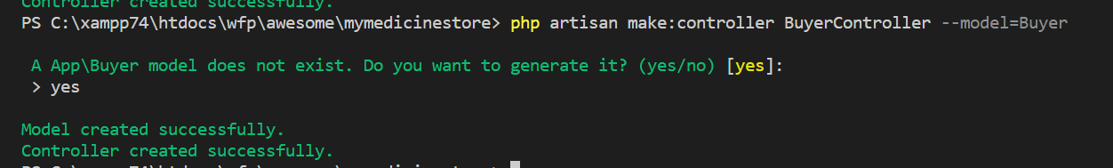
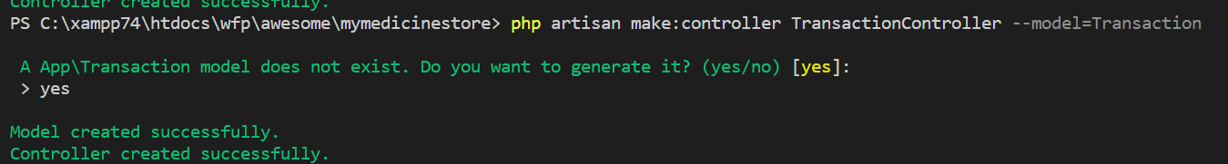
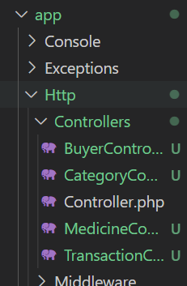
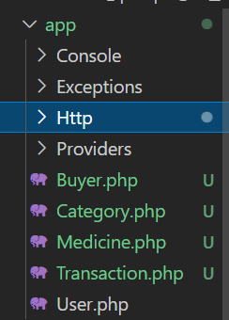

Slide 20
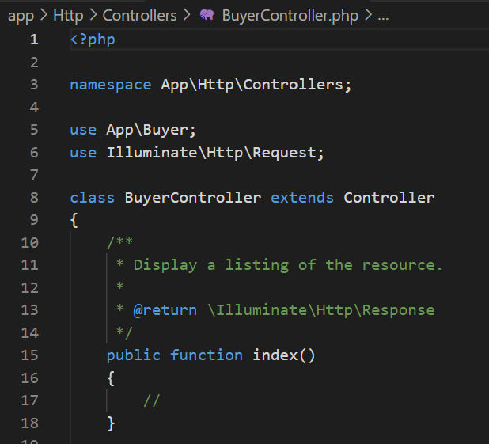

Slide 21
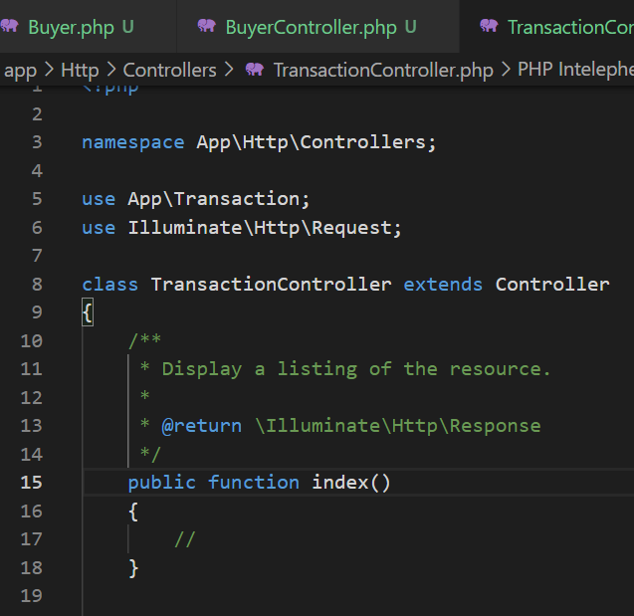

Slide 22
Make Relation between your Model

Slide 23
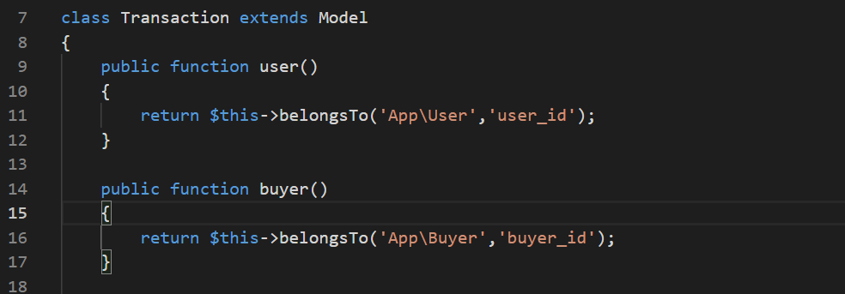
Transaction Model
Create One-to-many Relationships between Users and Buyers

Slide 24
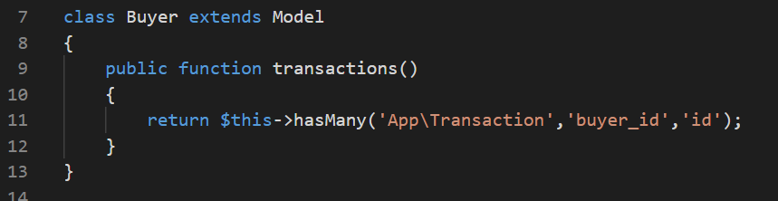
Buyer Model

Slide 25
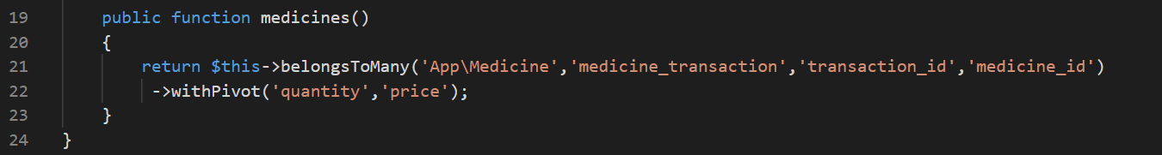
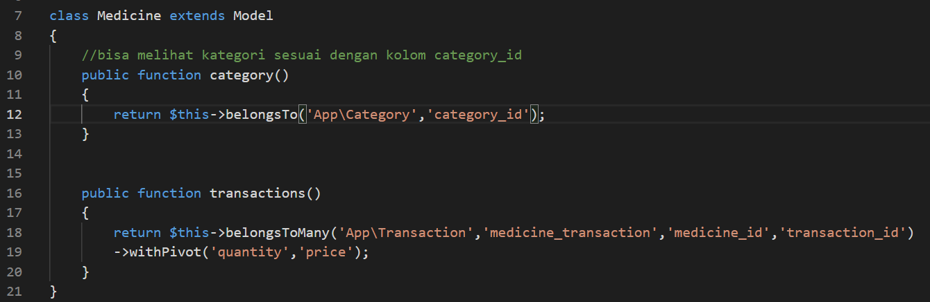
Create Many-to-many Relationship
Transaction has a many-to-many Relationship, so inside “Transaction model”
Inside “Medicines model”

Slide 26
Create a Transaction and Capital List View for detailed transaction details

Slide 27
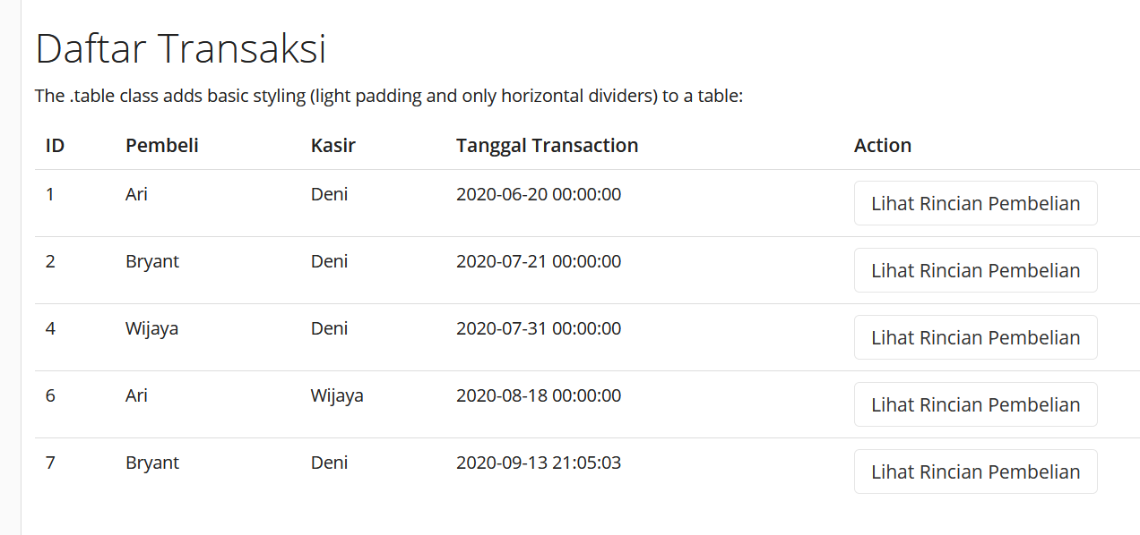
Expected result

Slide 28
Modification View Table
<table class="table" >
<thead>
<tr>
<th>ID</th>
<th>Pembeli</th>
<th>Kasir</th>
<th>Tanggal Transaction</th>
<th>Action </th>
</tr>
</thead>
<tbody>
@foreach($data as $d)
<tr>
<td>{{ $d->id }}</td>
<td>{{ $d->buyer->name }}</td>
<td>{{ $d->user->name }}</td>
<td>{{ $d->created_at }}</td>
<td><a class="btn btn-default" data-toggle="modal" href="#basic"
onclick="getDetailData({{$d->id}});">Lihat Rincian Pembelian</a></td>
</tr>
@endforeach
</table>

Slide 29
Modification AjaxJavaScript
function getDetailData(id) {
$.ajax({
type:'POST',
url:'{{route("transaction.showAjax")}}',
data:'_token= <?php echo csrf_token() ?> &id='+id,
success:function(data) {
$("#msg").html(data.msg);
}
});
}
Modification Routing Table for showAjax

Slide 30
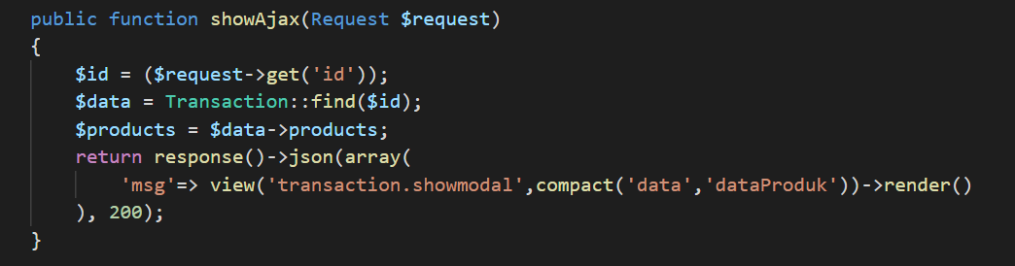
ShowAjax() function
ShowAjax's concept is the same as before i.e :
(a) take id value, (b) Find Object from this id, (c) Find the items

Slide 31
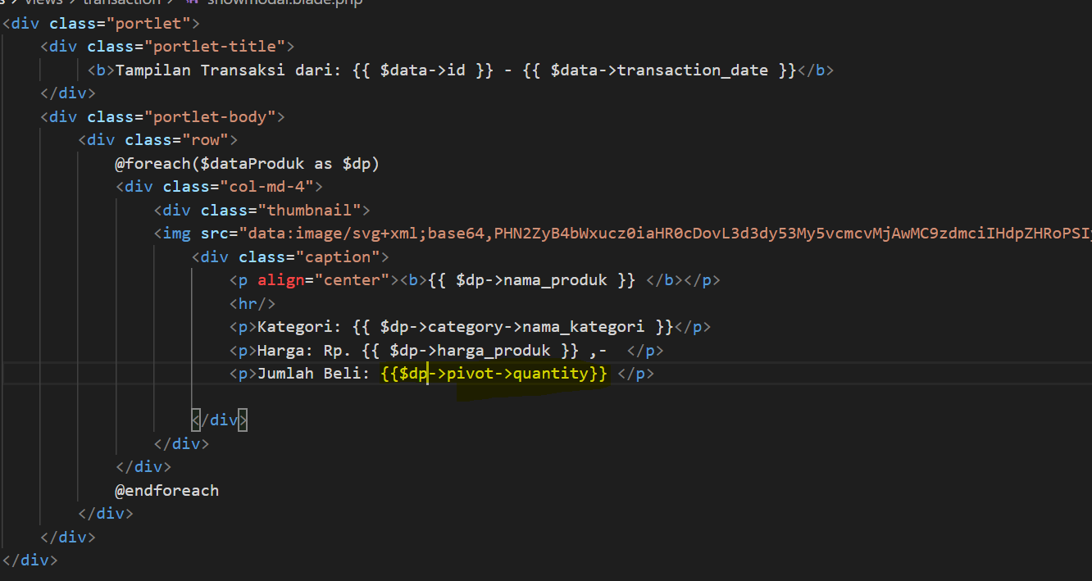
Pada View Modals
Because the quantity product is in the junction table, so you can call the value from the pivot of the many-to-many relationship

Slide 32
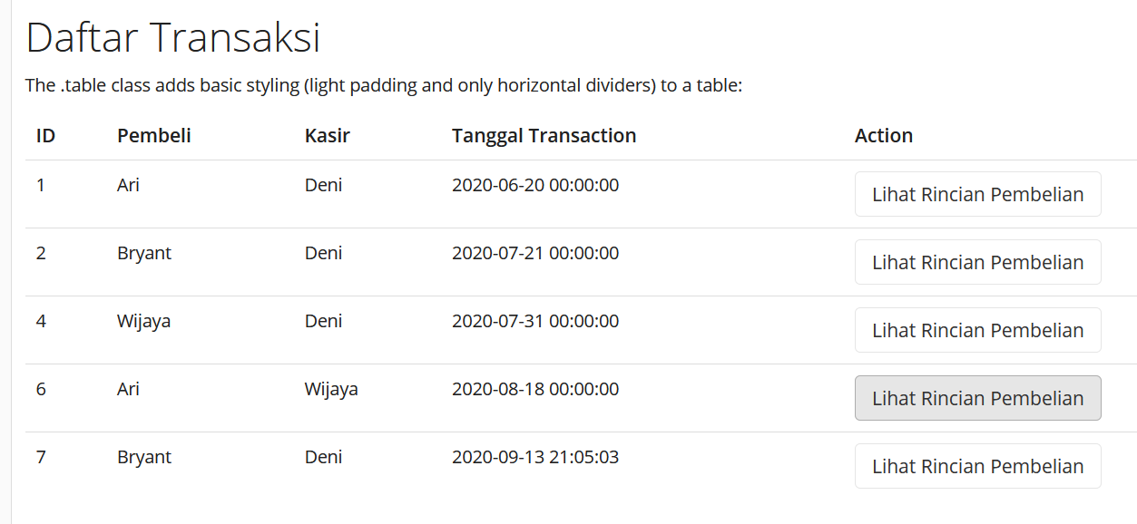
Result
If you press button from ID #6 so the result will be

Slide 33
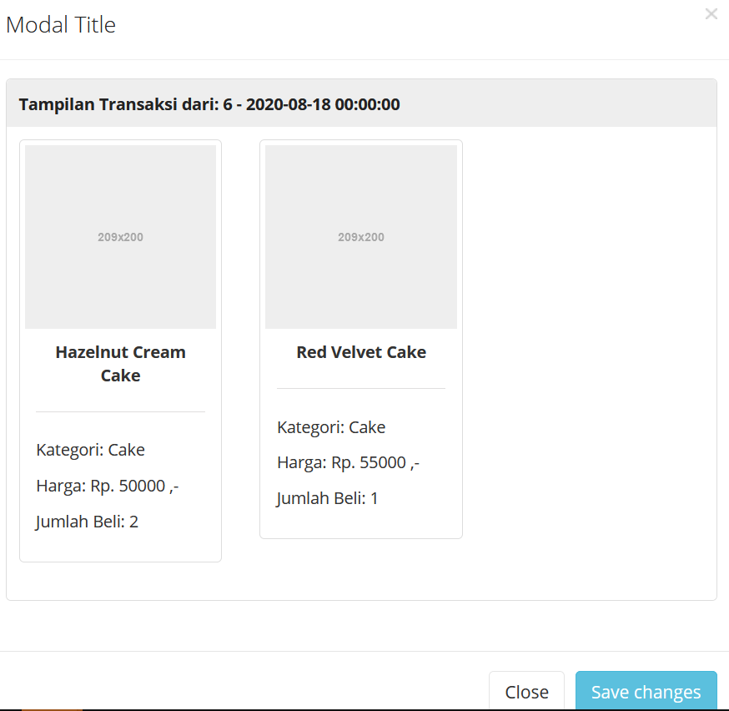
Obat X
Obat Y
Nyeri
Batuk

Slide 34
Step Learning
Make List View (slide 32)
Make action “Lihat Rincian Pembelian” and redirect with reload page (without Ajax). Show `kode transaction`, `create transaction`, list product (name, price and quantity)
Modification action “Lihat Rincian Pembelian” with Modals

Slide 35
Thank you

